Slide 1
Connectify
A Real time End-to-End Encrypted Chat App

Slide 2
Key Features
End-to-End Encryption: Messages are encrypted and decrypted locally for secure communication.
Real-Time Messaging: Powered by Socket.IO for instant message delivery.
User Authentication and Authorization: Secure signup, login, and logout functionality with JWT-based authorization.
Global State Management: Zustand is used for efficient and lightweight state management across the application.
Error Handling: Comprehensive error handling for both frontend and backend to ensure a smooth user experience.
Online Status: View online users in real-time.

Slide 3
Tech Stack
Frontend:
React: For building the user interface.
Vite: For fast development and build processes.
TailwindCSS: For styling.
Zustand: For state management.
React Router: For client-side routing.
Socket.IO Client: For real-time communication.
RSA (Asymmetric Encryption): For encrypting messages and securely exchanging keys.
Backend:
Node.js: For server-side logic.
Express: For building RESTful APIs.
MongoDB: For database storage.
Mongoose: For object data modeling.
Socket.IO: For real-time communication.
Cloudinary: For image storage.
JWT: For secure authentication.

Slide 4
Message Flow
Server
3. Send public key of recipient to sender.
5. Store encrypted message in MongoDB and send it to receiver via Socket.
Sender (Client)
1. Type a message.
2. Send to local DB.
3.Fetch pubic key of recipient.
4. Encrypt it.
5. Send to Server
via Socket.
Receiver (Client)
5. Fetch Encrypted message
6. Retrieve private key from local DB
7. Decrypt received message.
8. Retrieve sent message from local DB
9. Arrange then Display them.
IndexedDB (sender)
2. Store unencrypted message
IndexedDB (sender)
6. Send private key.
8. Send sent message.

Slide 5
Authentication Flow
Login & Signup
User
Client
API Gateway
Database
JWT Service
Initiate Request
Request to /api/auth/signup or
/api/auth/login
SignUp
Create user
User Created
login
Check users credentials
Credentials valid
Generate JWT
JWT Generated
Send JWT in cookies
Display results

Slide 6
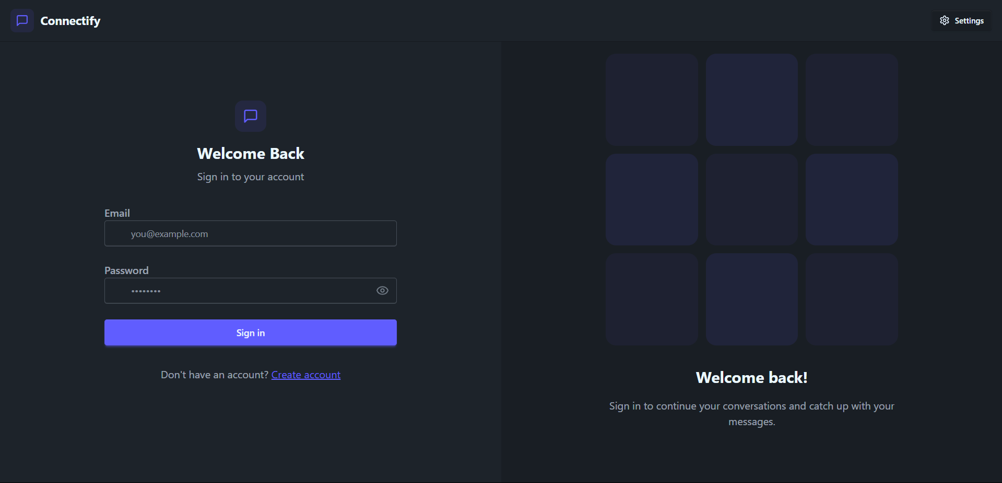
App Walkthrough
– Login Page

Slide 7
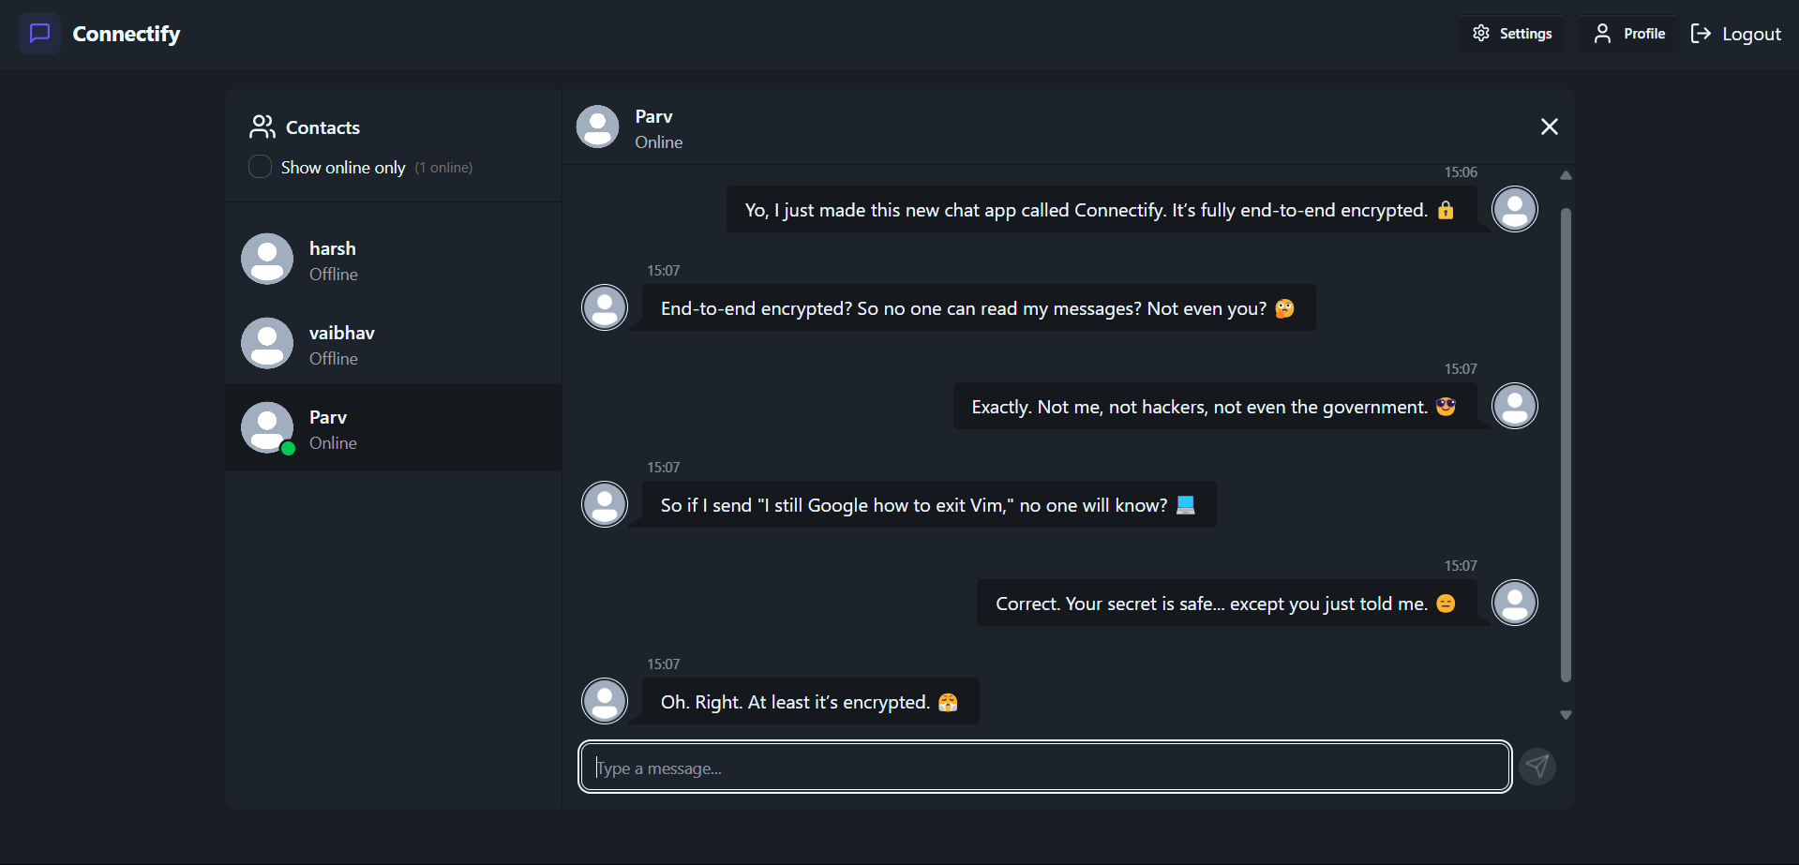
App Walkthrough
– Chat Box

Slide 8

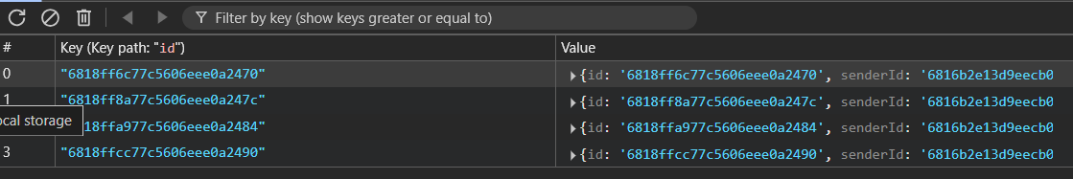
App Walkthrough
– Data Base (Local)
To store Private Key
To store Sent Messages

Slide 9
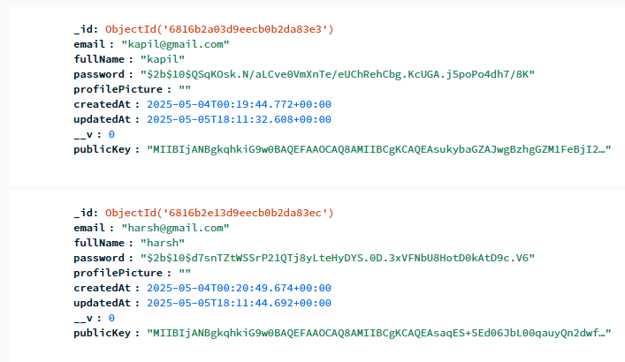
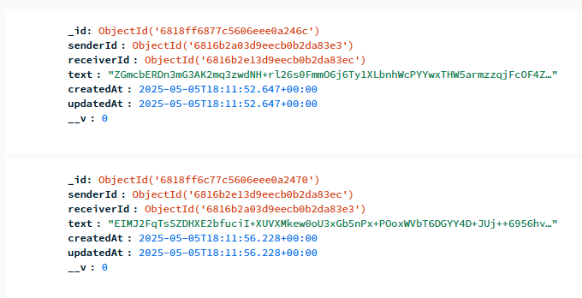
App Walkthrough
– Data Base (MongoDB)
User DB – Store user information
Message DB – Stores encrypted messages

Slide 10
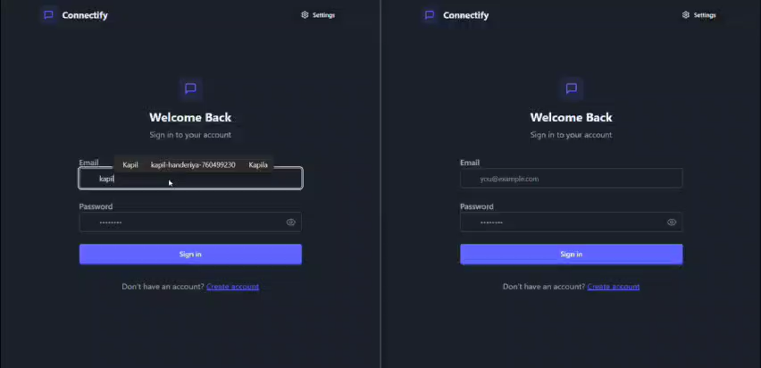
App Walkthrough
– Demo Video

Slide 11
Future Enhancements
Retrieve Chat History: Implement functionality to fetch previous chats from the server after a user logs back in.
Group Chats: Enable multiple users to communicate in a single conversation.
File Sharing: Allow users to share files securely with end-to-end encryption.
Dark Mode: Add a dark theme for better user experience.
Push Notifications: Notify users of new messages even when the app is closed.
Gmail Authentication: Integrate Google Sign-In for seamless and secure user authentication.
Message Reactions: Add emojis or reactions to messages for better engagement.

